Slide 1

NFlixbot Evolution
Xinran Yu
Sheida Majidi
Rohan Kumar
Group 11
Xinran Yu
Sheida Majidi
Rohan Kumar
Notes:
Prepare a presentation as the version for pitching your ideas to the company.
- Introduce group & role (Include your name on the first presentation slides)
- Explain scenarios
- Share prototype of your chatbot (Code demo).
[Recommend] You can also generate 2-3 min demo video clip as well.
=> You will have 8 minutes in total, but try to finish your presentation within 5 minutes with a concise code demo.

Slide 2
What NFlix provides
2. How NFlix works
3. Why NFlix is needed
Table of Contents

Slide 3
01
Scenarios

Slide 4
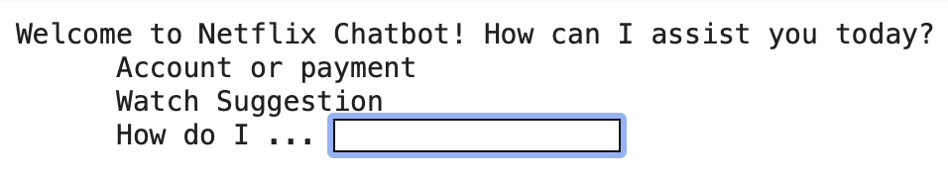
Welcome Message
Account / Payment
Movie Suggestion
How do I ..?
Feedback
1. Account and pricing
2.Login/password issues
3.Update payment info
4.Return a video
5.Subscription problems/Cancel
6.Close account
1. Movie
2.TV shows
1. Search for a title
2.Access languages for subtitle
3.Register/deregister a device
4.Access purchased/rented videos
5.Enable/disable parental control
6.Update my country
(Sentiment Analysis on users’ feedback)

Slide 5
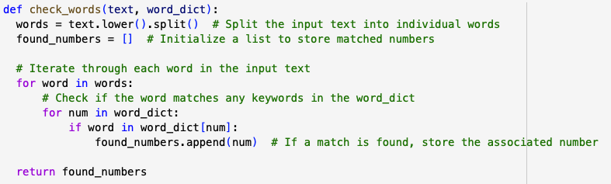
FUNCTION: check_words
check_words()
Notes:
Here is the most important function in the code. The function contains two parameters:
Text: in context is the response from the user
Word_dictionary: containing keywords as keys and associated numbers as values
The code's purpose is to identify specific list of numbers associated with keywords found in the input text.
The given number will lead the users to the next step in the conversation
Give examples in demo

Slide 6
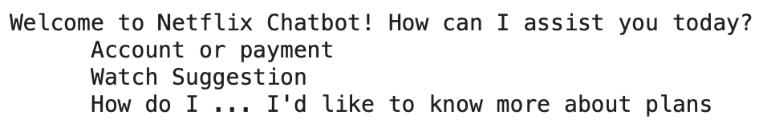
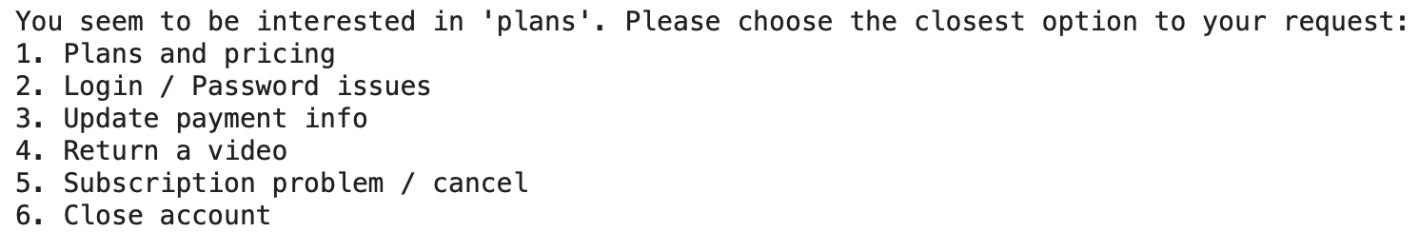
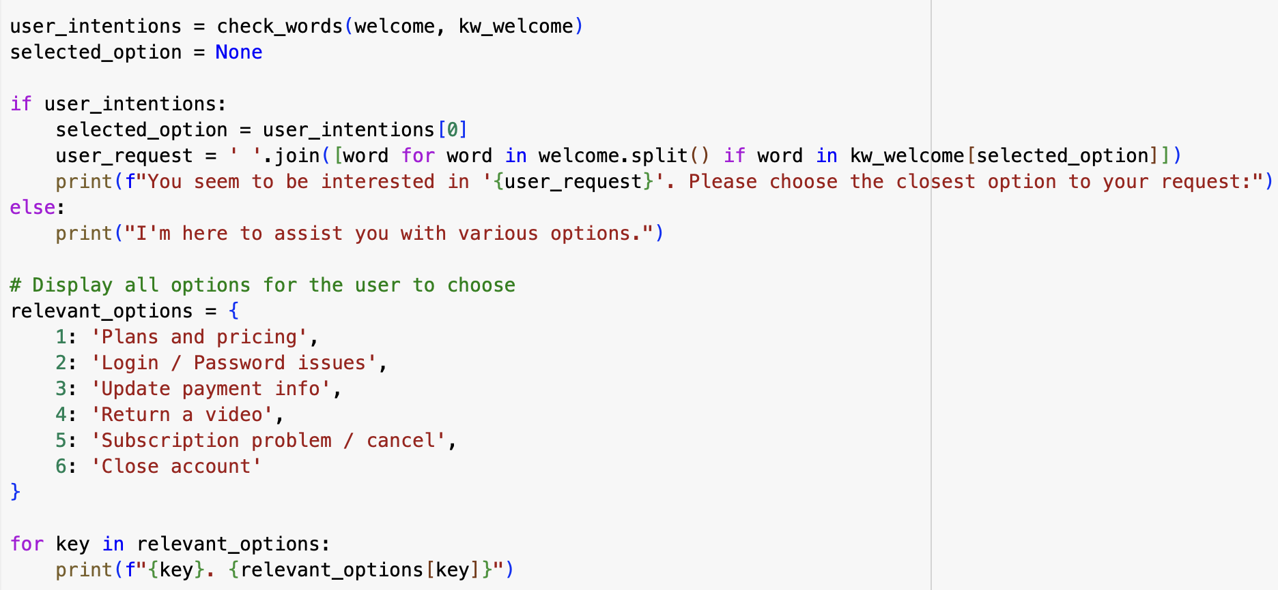
Plans and pricing
Login / password issues
Update payment info
Return a video
Subscription problems / cancel
Close account
Account or Payment

Slide 7
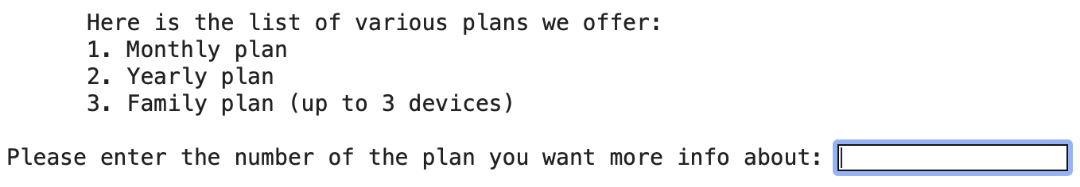
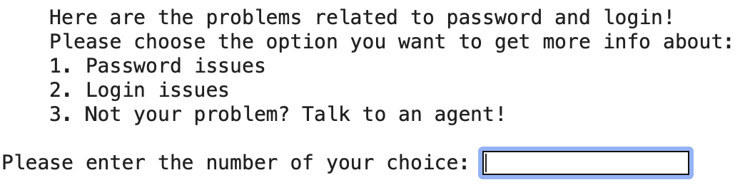
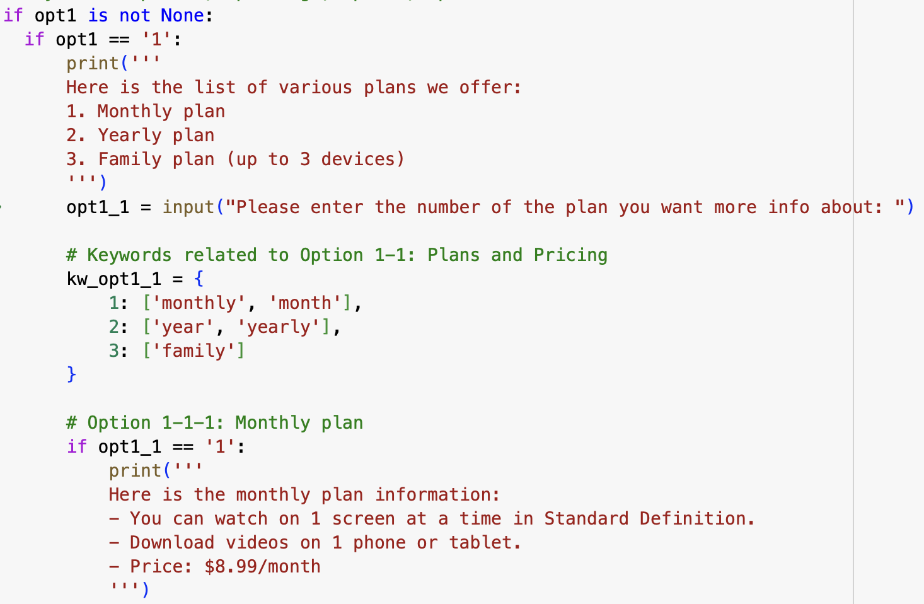
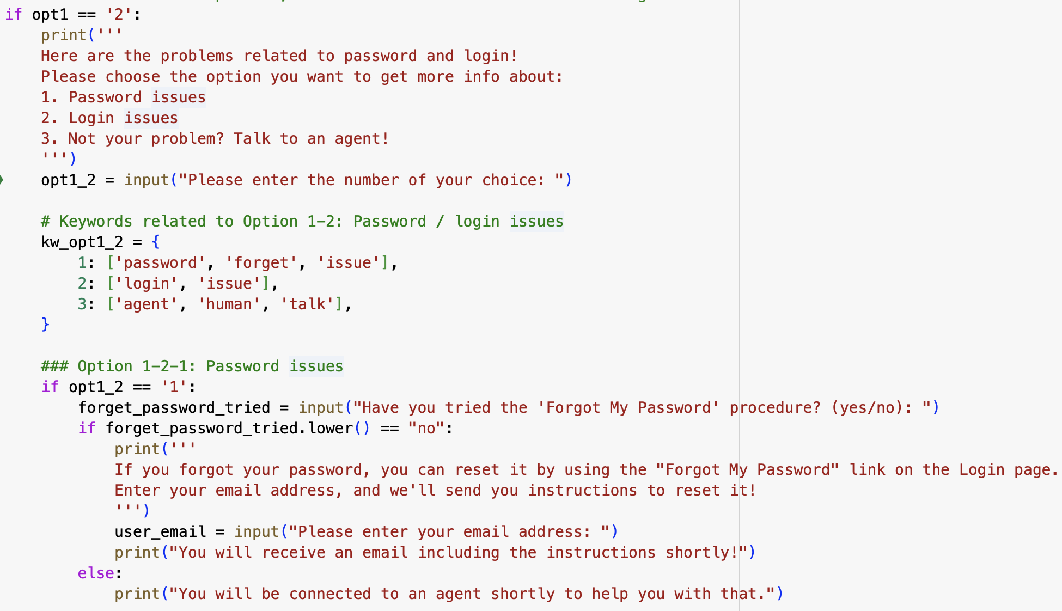
Plans and Pricing
Login/Password issues

Slide 8
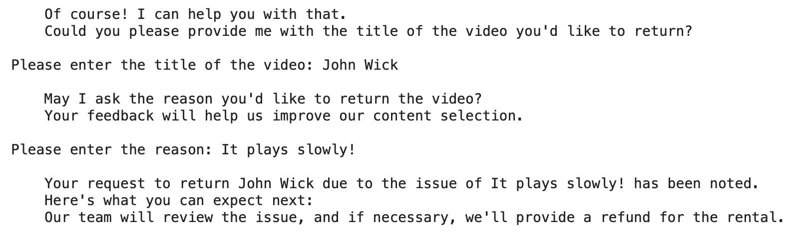
Update Payment info
Return a Video
Subscription Problems/Close account

Slide 9
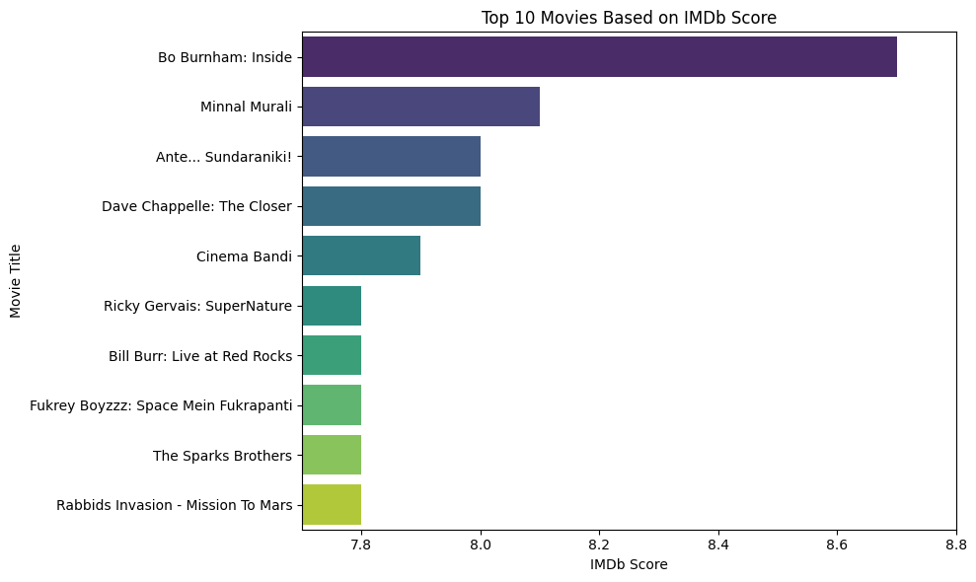
Watch Suggestion
Based on user’s preference
On genres and released year
Library:
Seaborn
matplotlib
Give the top 10 suggestions ranked by imdb score
Notes:
Movie suggestion:
In this section the chatbot will give the watch suggestion for users based on their request on released year and genres, and rank the top 10 suggestions by imdb score
we used the libraries, seaborn and matplotlib, both are data visualization tools on python.
aiming a higher user engagement on netflix.

Slide 10
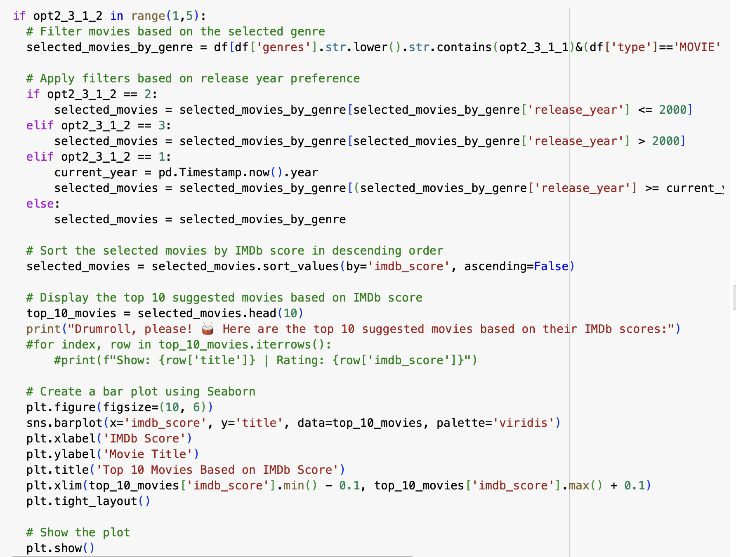

Slide 11
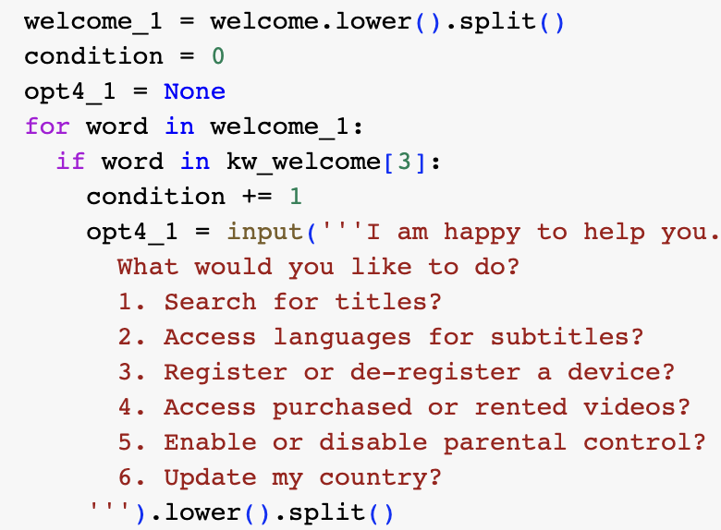
How do I … ?
Search for titles
Access languages for subtitles
Register/remove a device
Access purchased/rented movies
Enable/disable parental control
Update my country

Slide 12
Feedback
Sentiment Analysis on user feedback
Functions: remove_stopwords, sentiment_score
Steps：
Verify user’s identity
Ask user to provide feedback
Perform sentiment analysis
Append the analyzed data to dataframes
Notes:
performs sentiment analysis on user feedback after every conversation
The code first verifies user identity based userid and password belongs to the dataframe of user information we have. then collects user feedback, use functions to processes their input, performs sentiment analysis, and appends the analyzed data to DataFrames.
The code aims to improve Netflix's services based on user suggestions

Slide 13
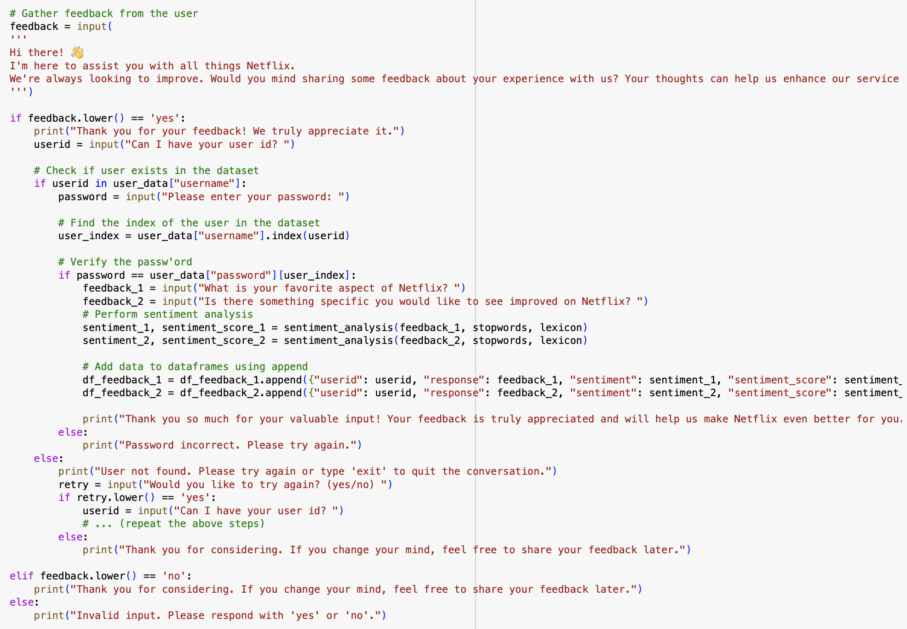

Slide 14
02
NFlixbot
How it works?

Slide 15
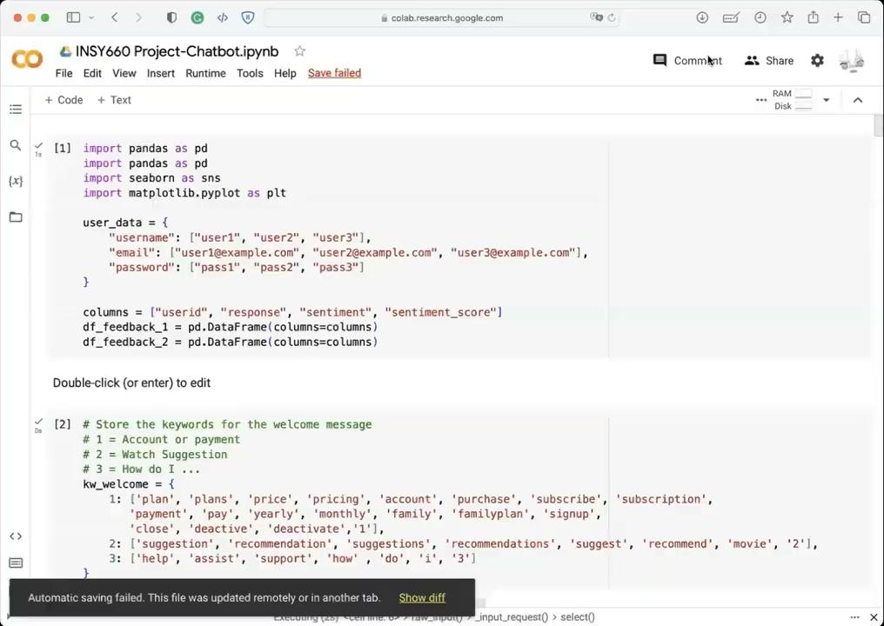

Slide 16
03
Added Values

Slide 17
Why a Chatbot is needed
Conversational Interface
24/7 Availability
Data Collection and Analysis
Personalized recommendations
Promotions and Marketing
Mood-Based Recommendations
Other competitors like Hulu have a chatbot

Slide 18
THANKS!
DO YOU HAVE ANY QUESTIONS?

